Slide 1
Unit 2
Cloud computing architecture

Slide 2
LEARNING OBJECTIVES DEVELOP BASIC UNDERSTANDING OF CLOUD COMPUTING
CONCEPTS
ARCHITECTURE
CHARACTERISTICS
SERVICE MODELS
TYPES OF DEPLOYMENTS MODELS
AVAILABLE CLOUD SERVICES & OPEN SOURCE SOLUTIONS

Slide 3
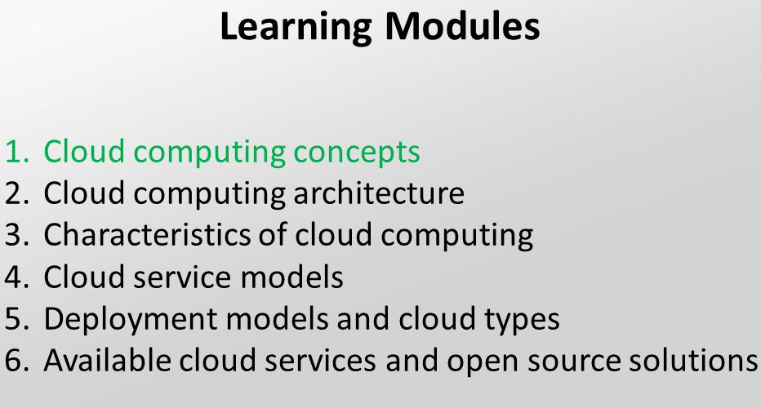

Slide 4
CLOUD COMPUTING CONCEPTS 1. EVOLUTION OF DISTRIBUTED COMPUTING 2. CC HISTORY 3.CC CONCEPTS

Slide 5
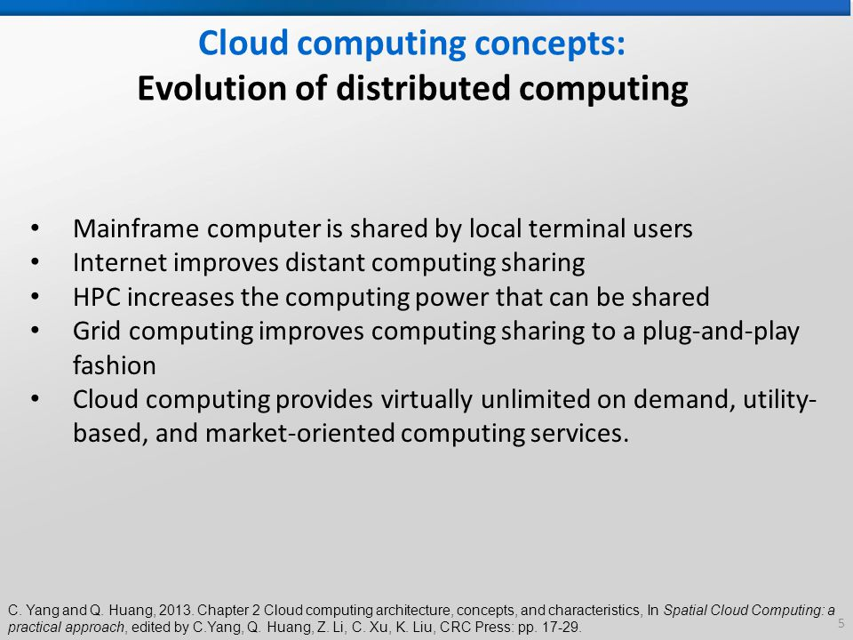

Slide 6
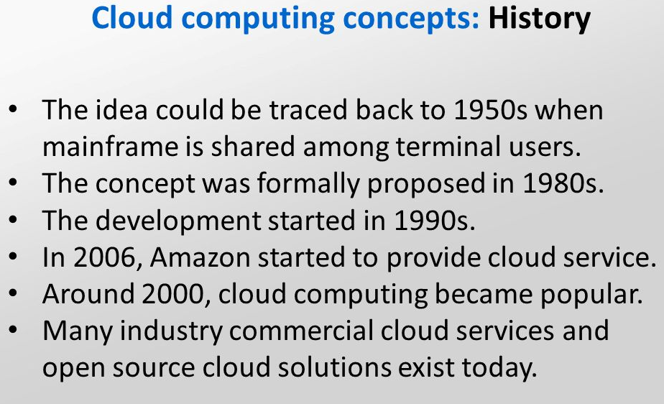

Slide 7
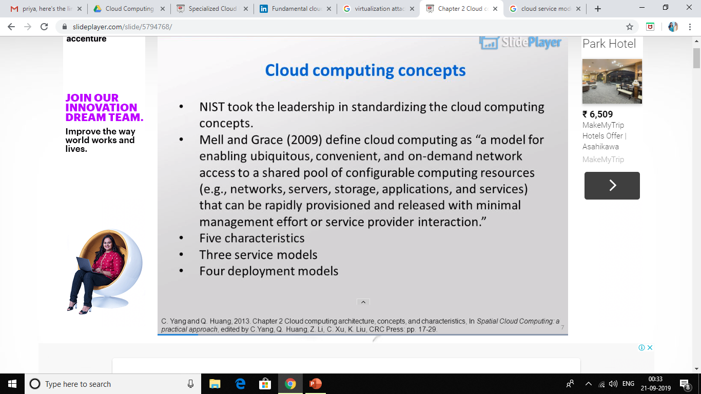

Slide 8
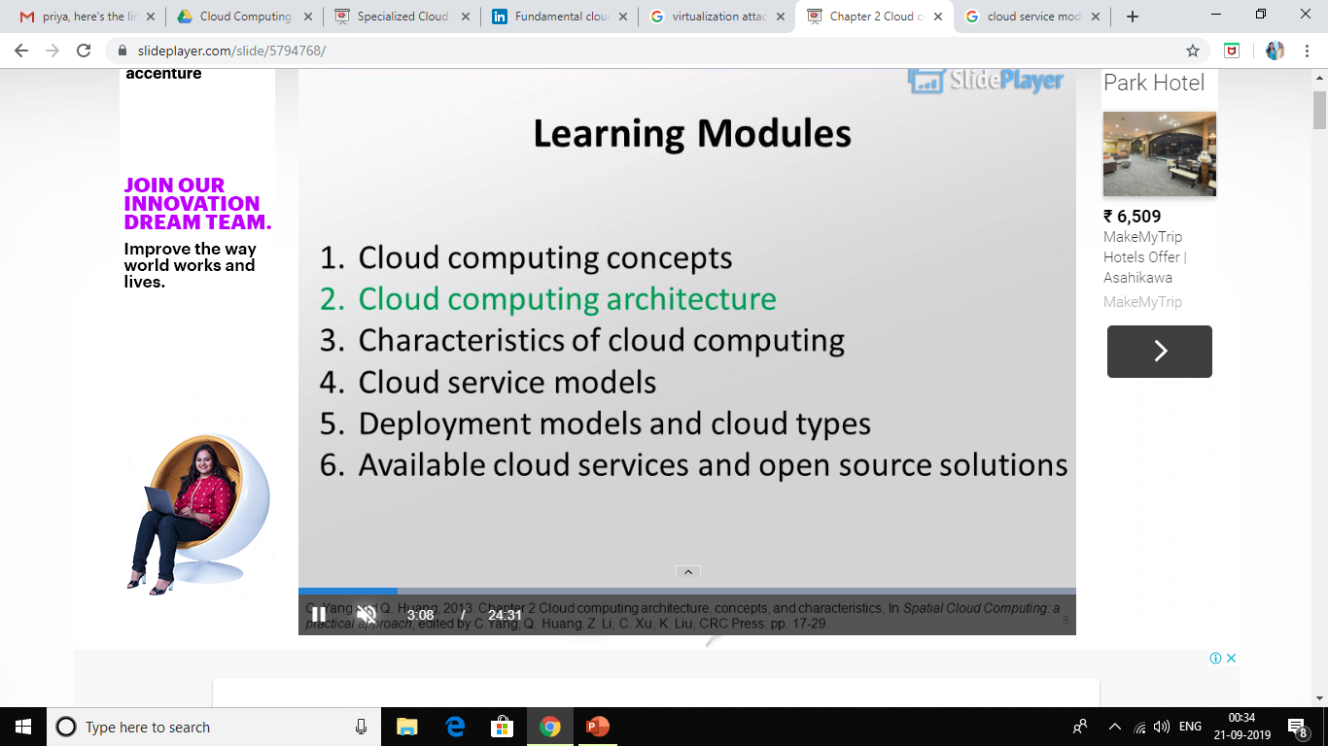

Slide 9
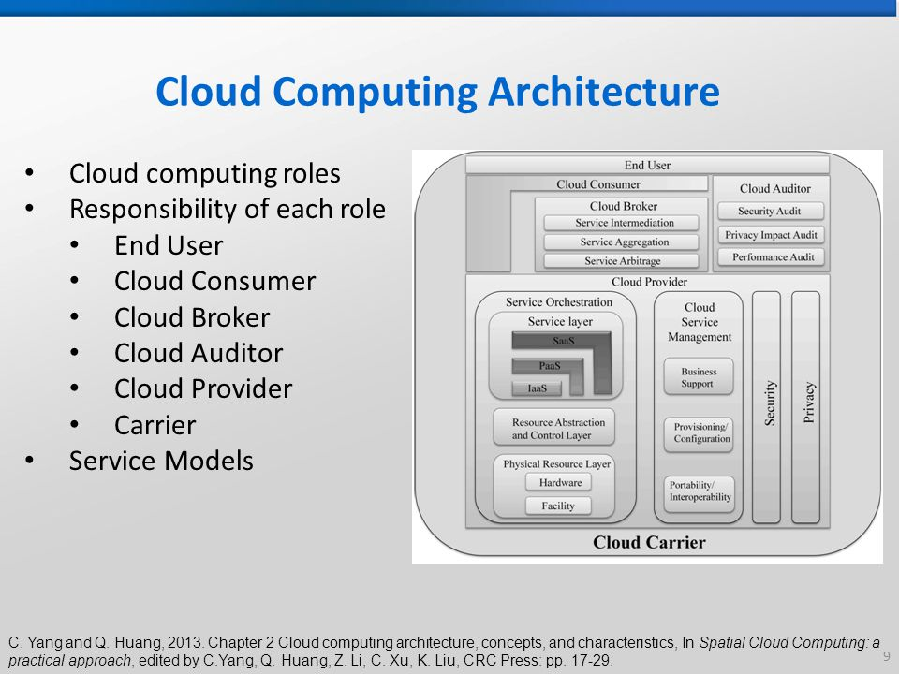

Slide 10
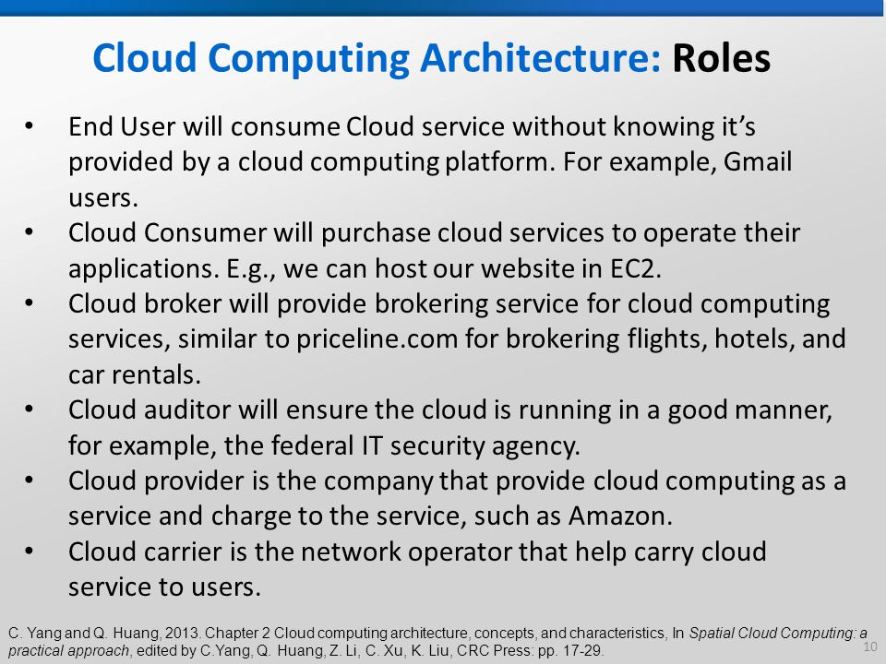

Slide 11
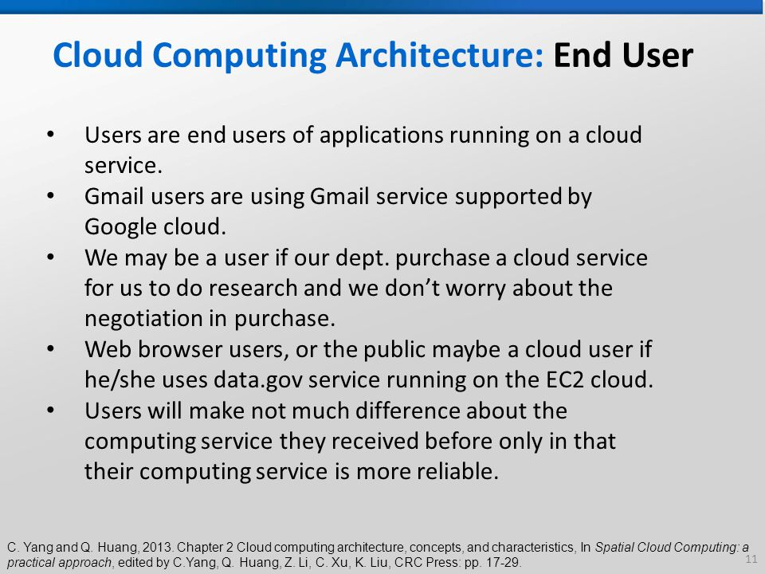

Slide 12
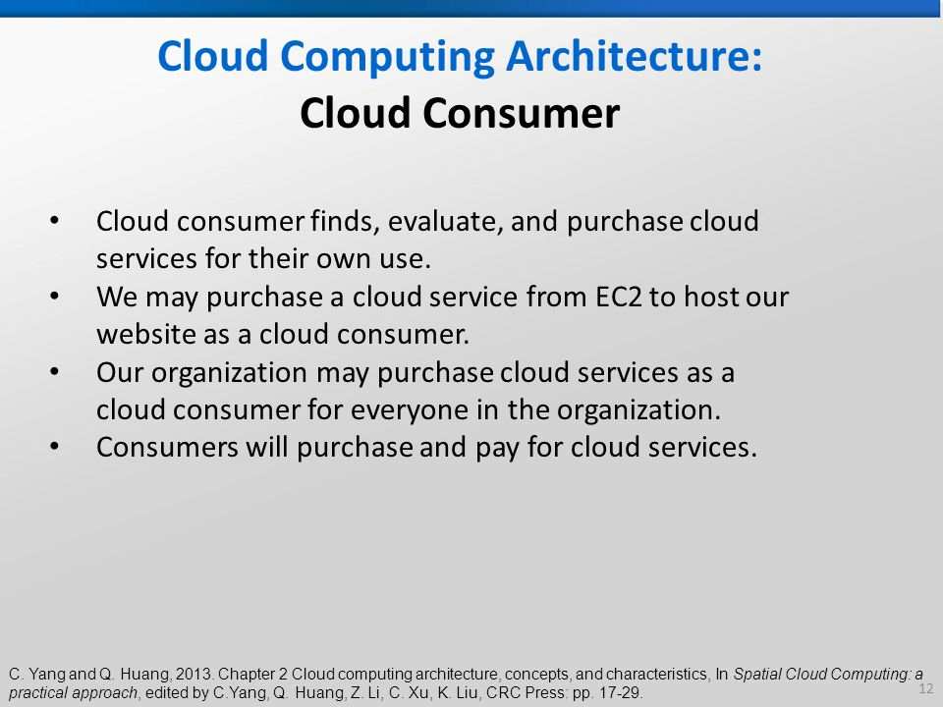

Slide 13
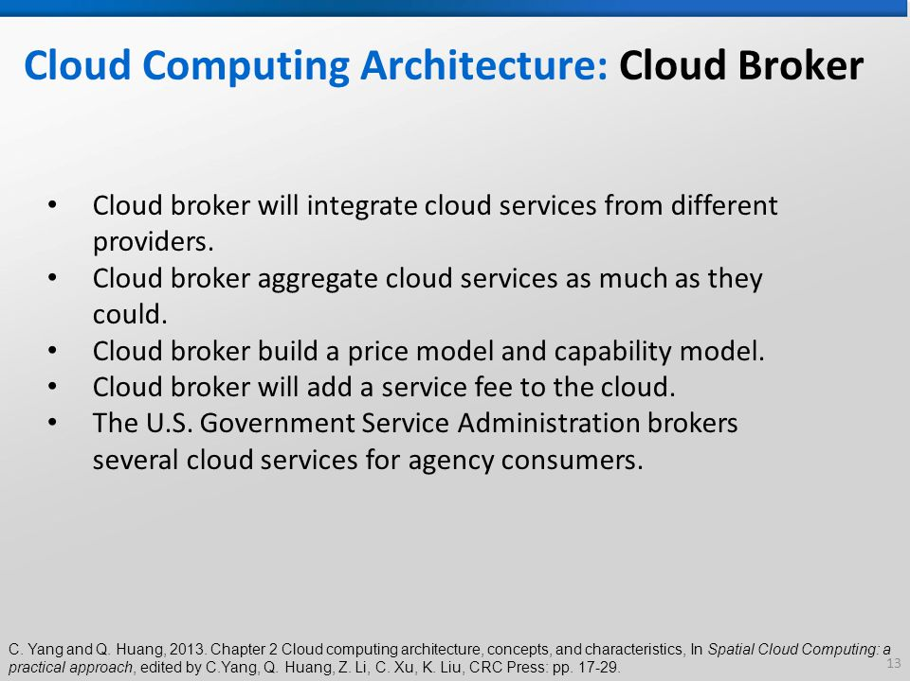

Slide 14
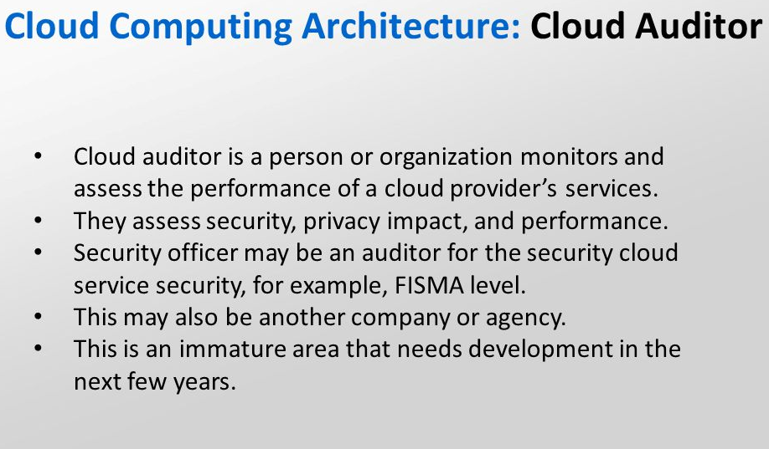

Slide 15
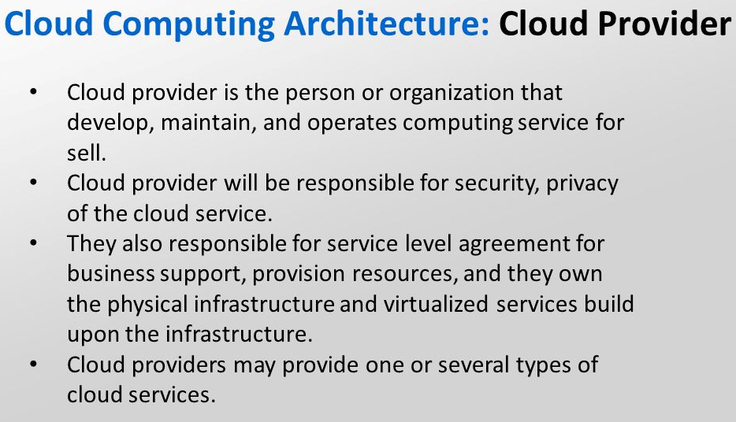

Slide 16
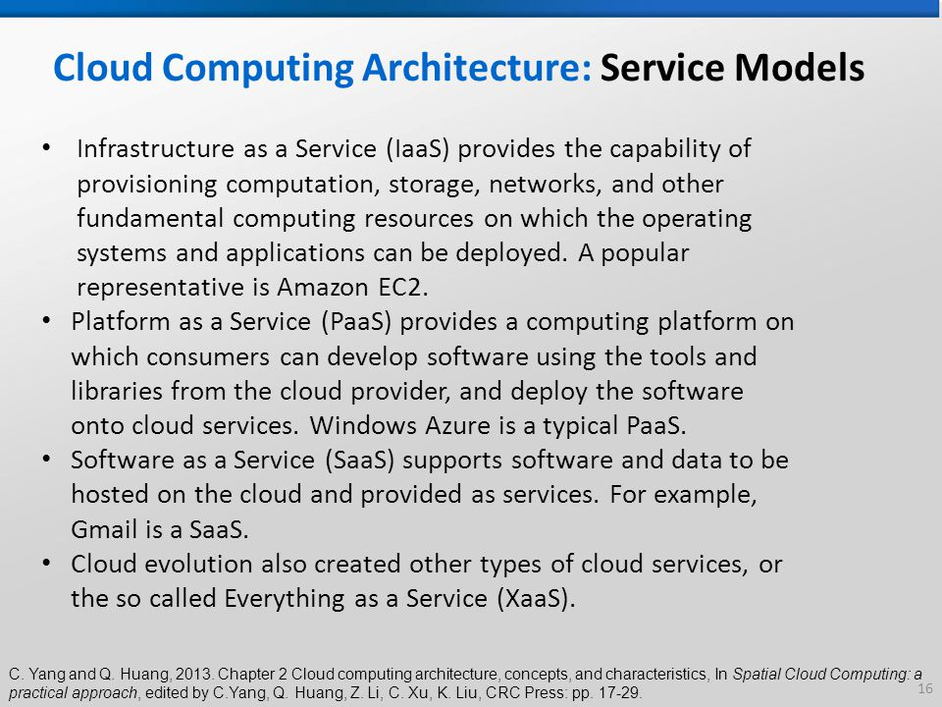

Slide 17
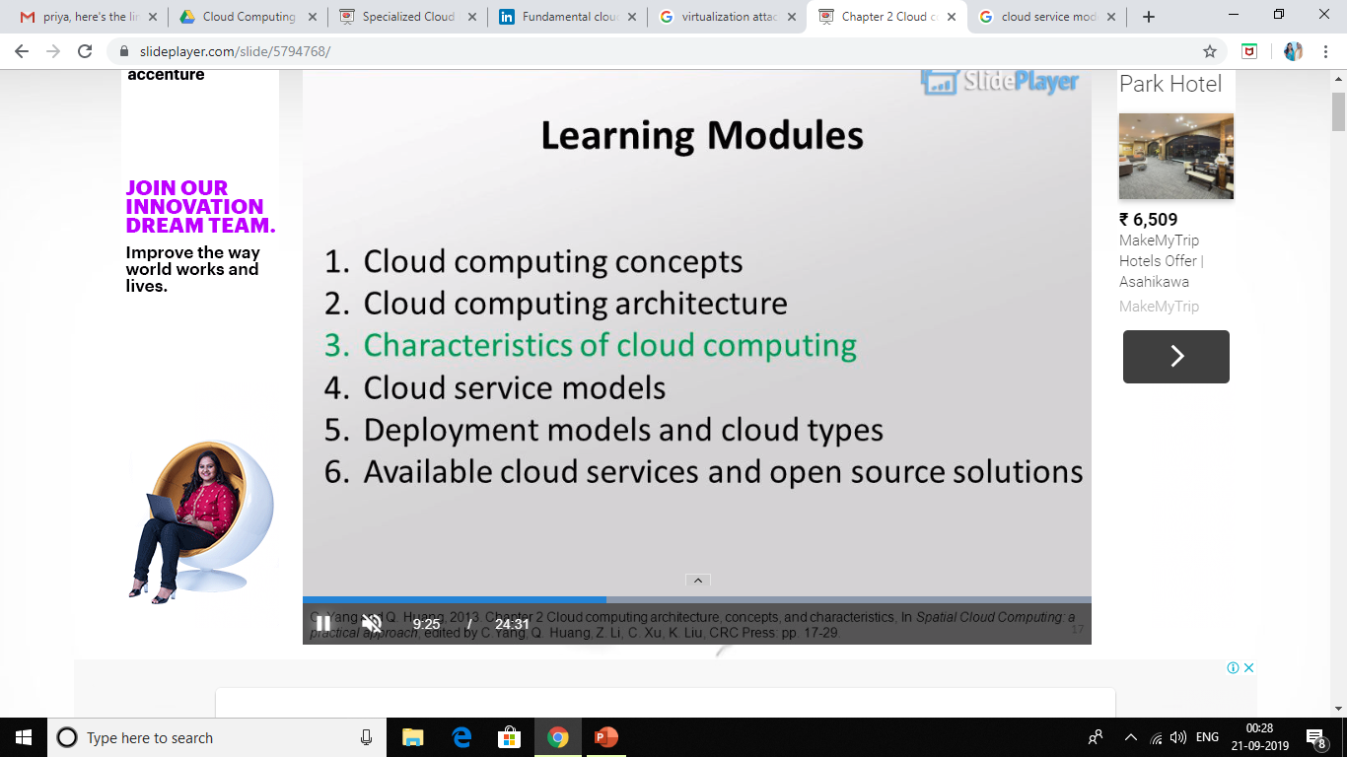

Slide 18
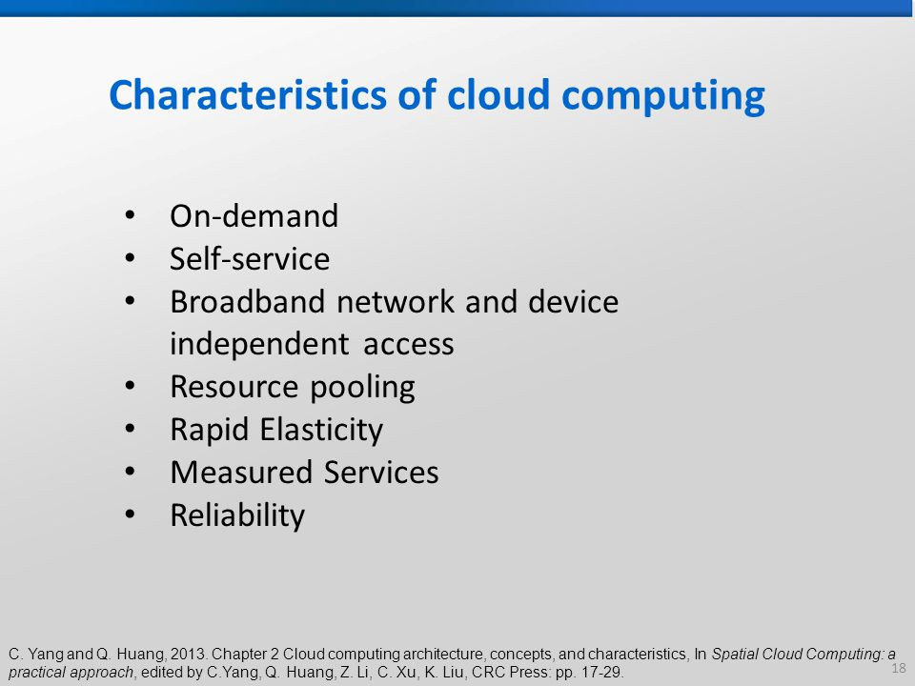

Slide 19
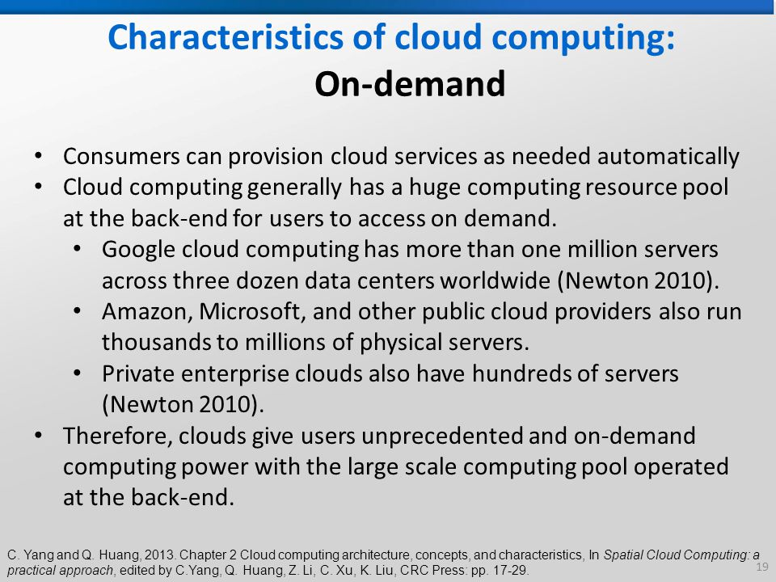

Slide 20
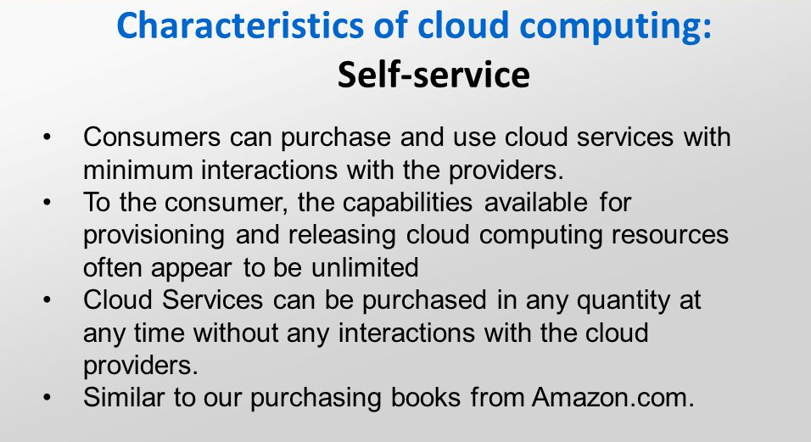

Slide 21
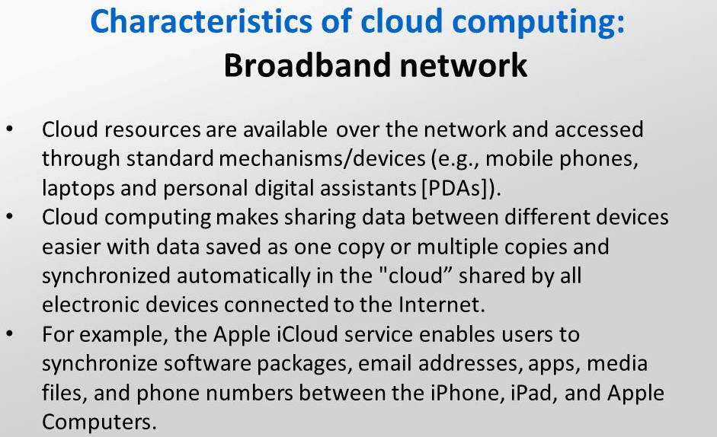

Slide 22
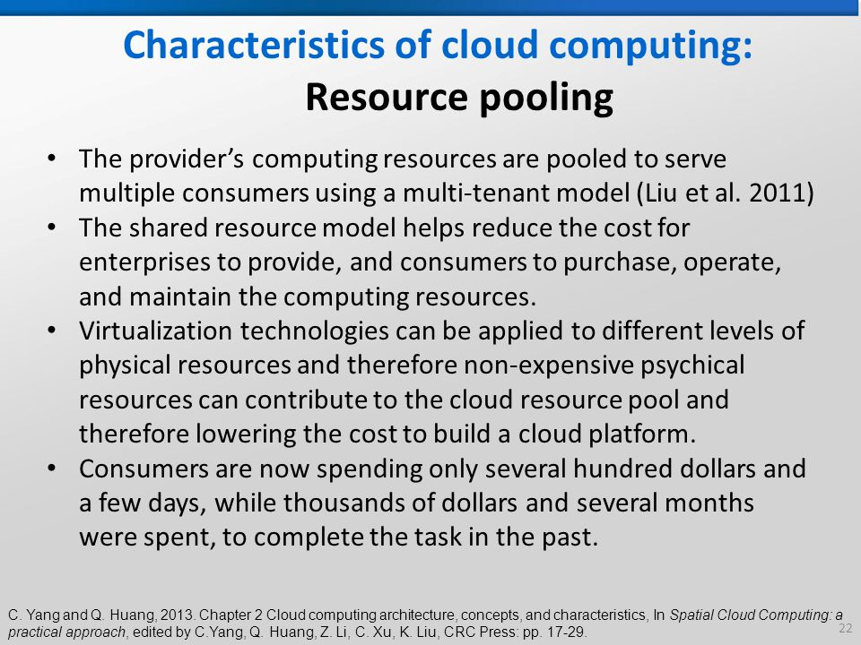

Slide 23
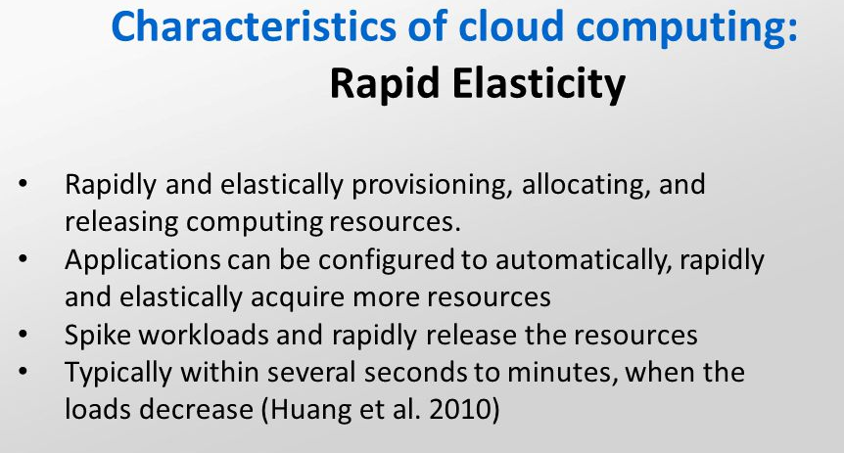

Slide 24
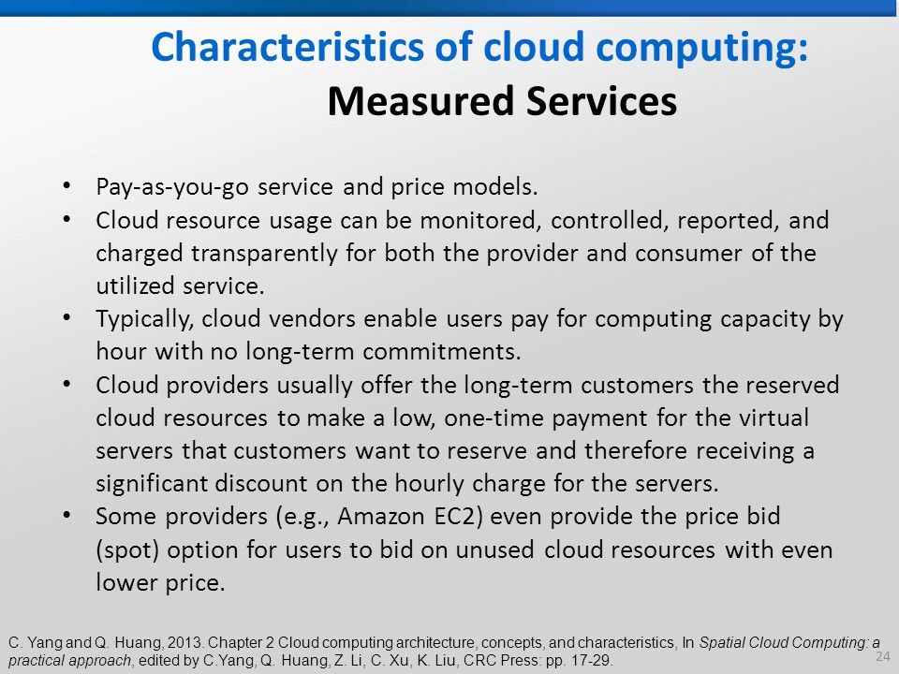

Slide 25
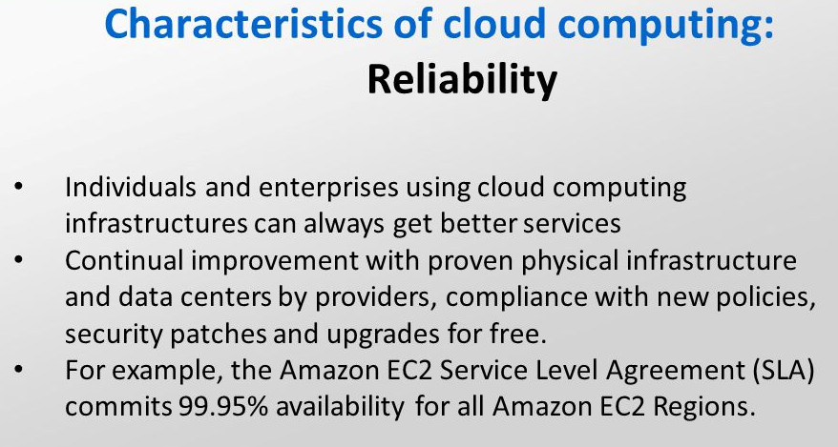

Slide 26
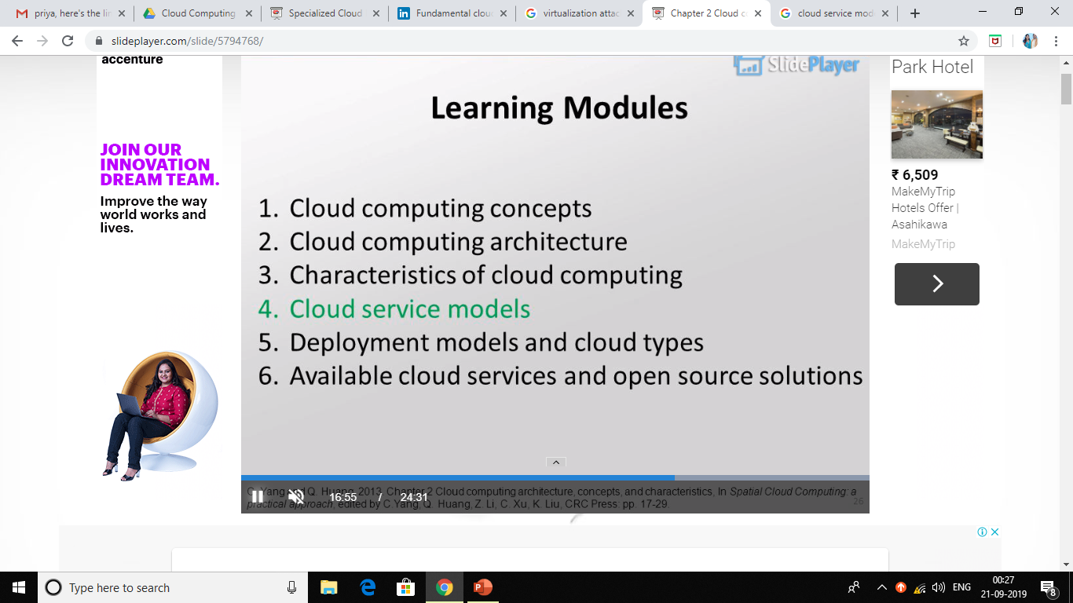

Slide 27
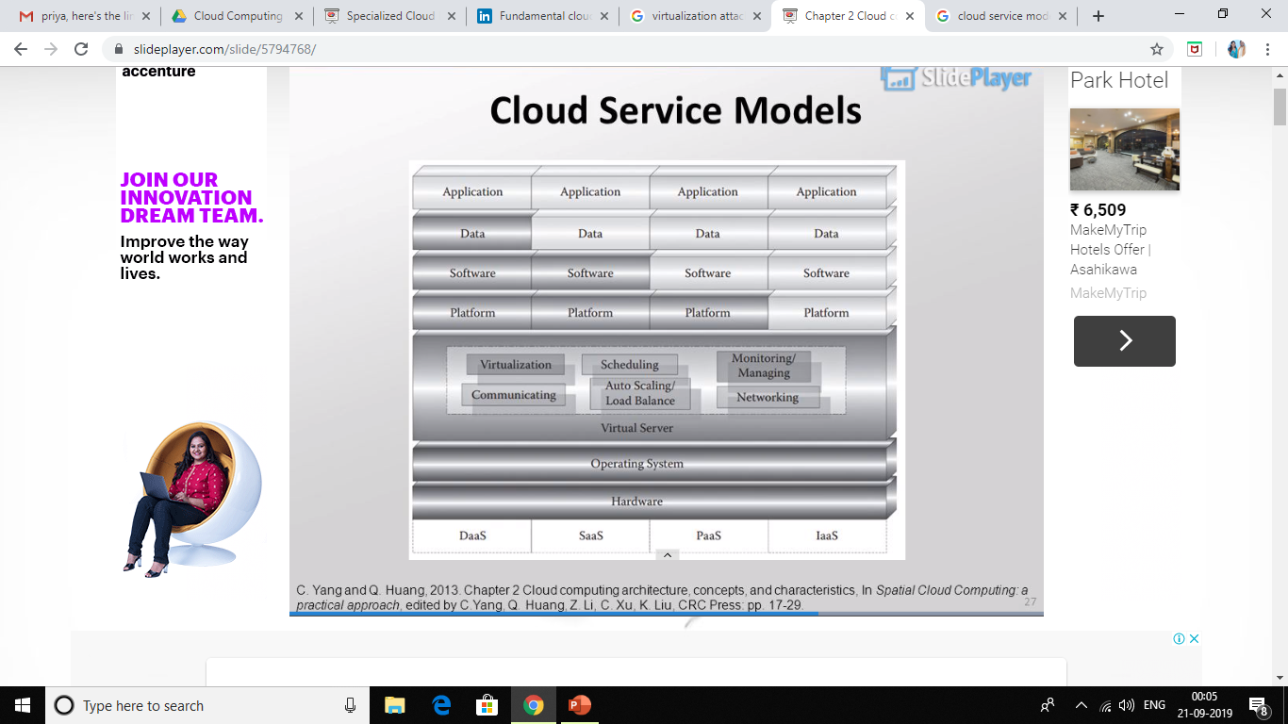

Slide 28
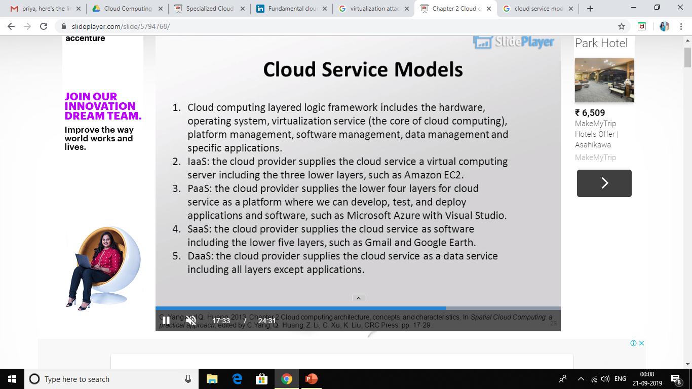

Slide 29
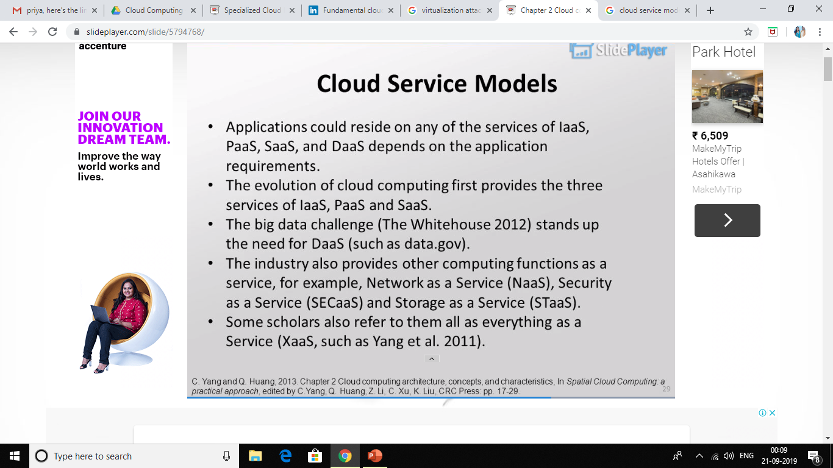

Slide 30


Slide 31
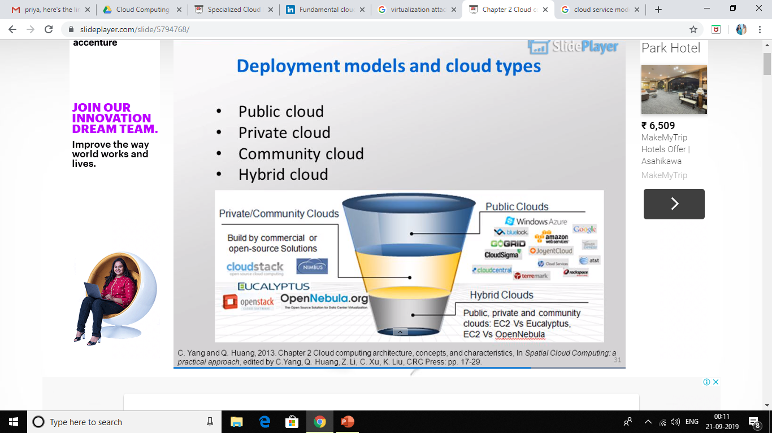

Slide 32
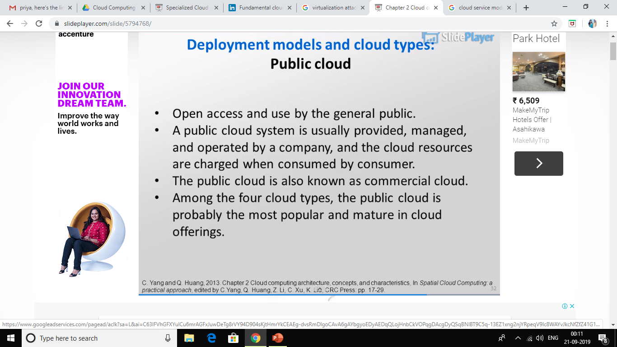

Slide 33
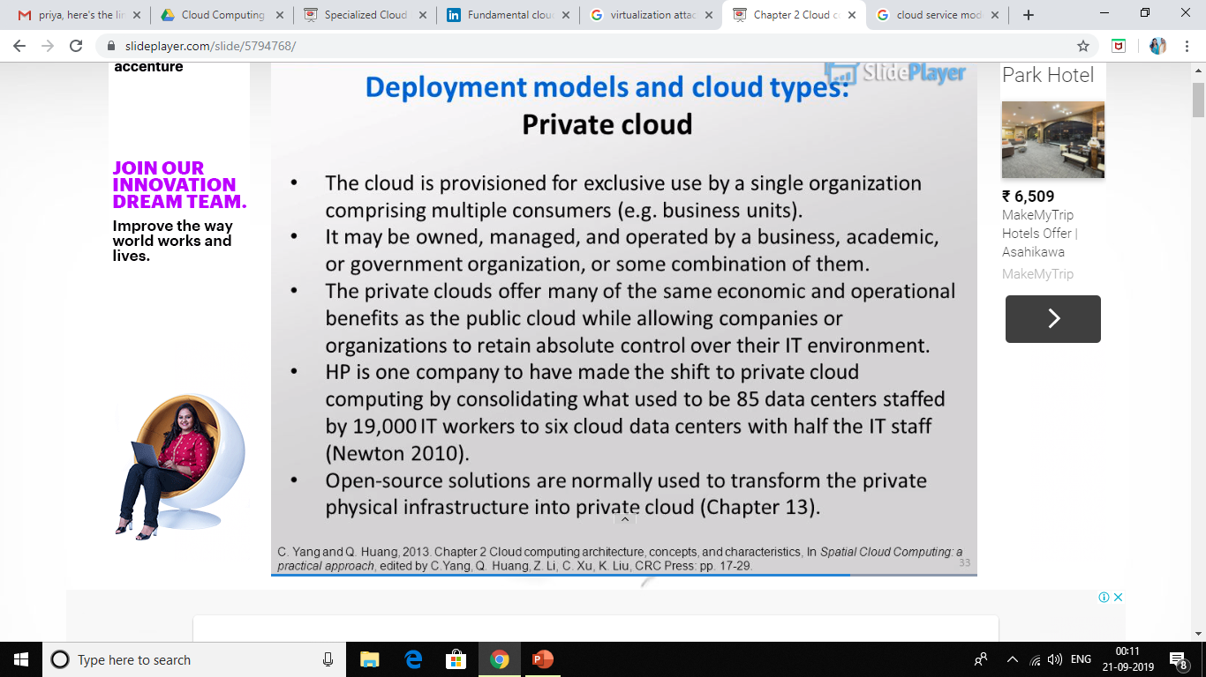

Slide 34
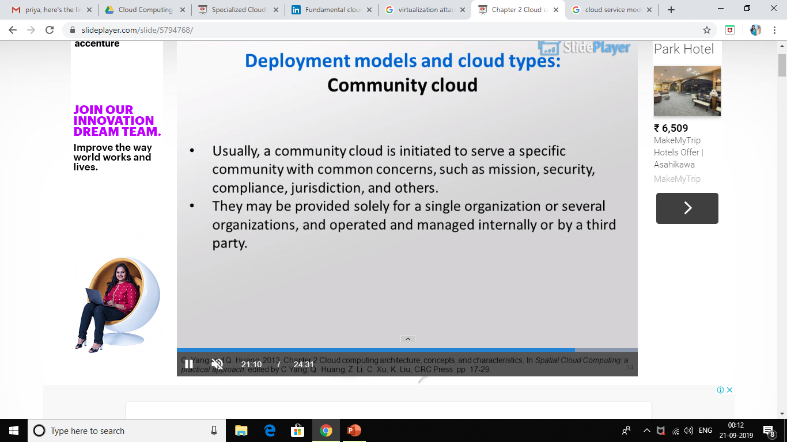

Slide 35
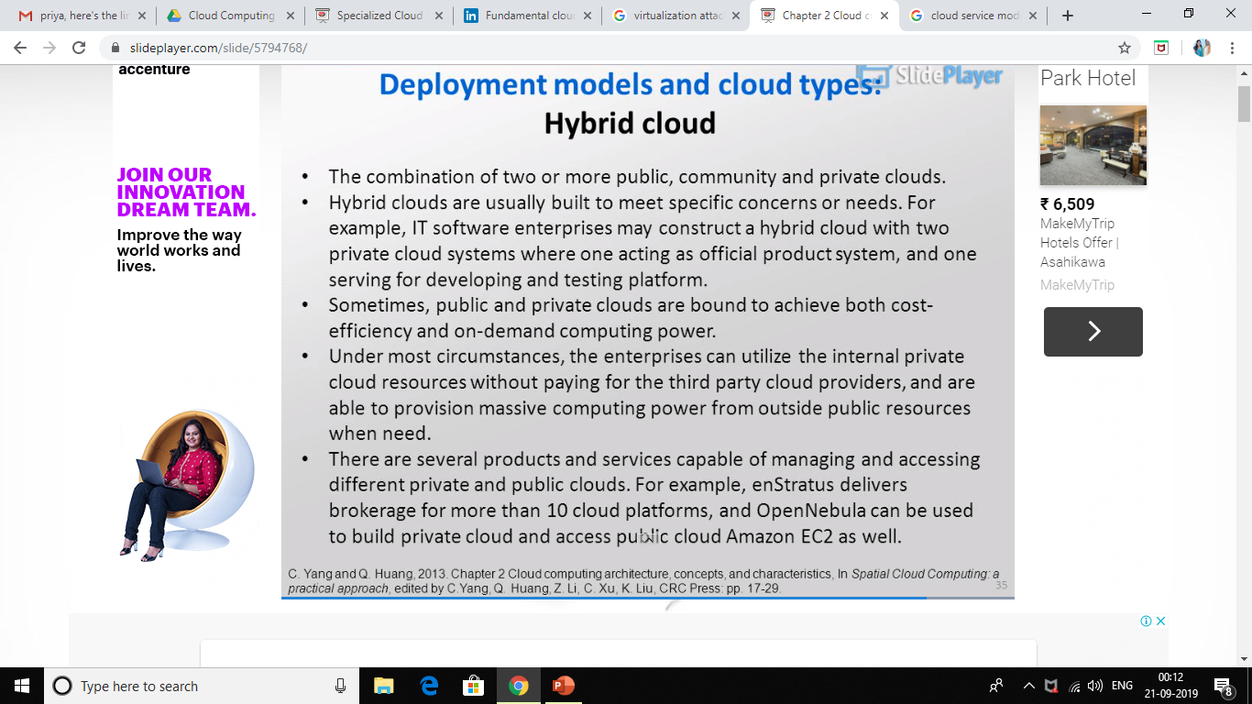

Slide 36
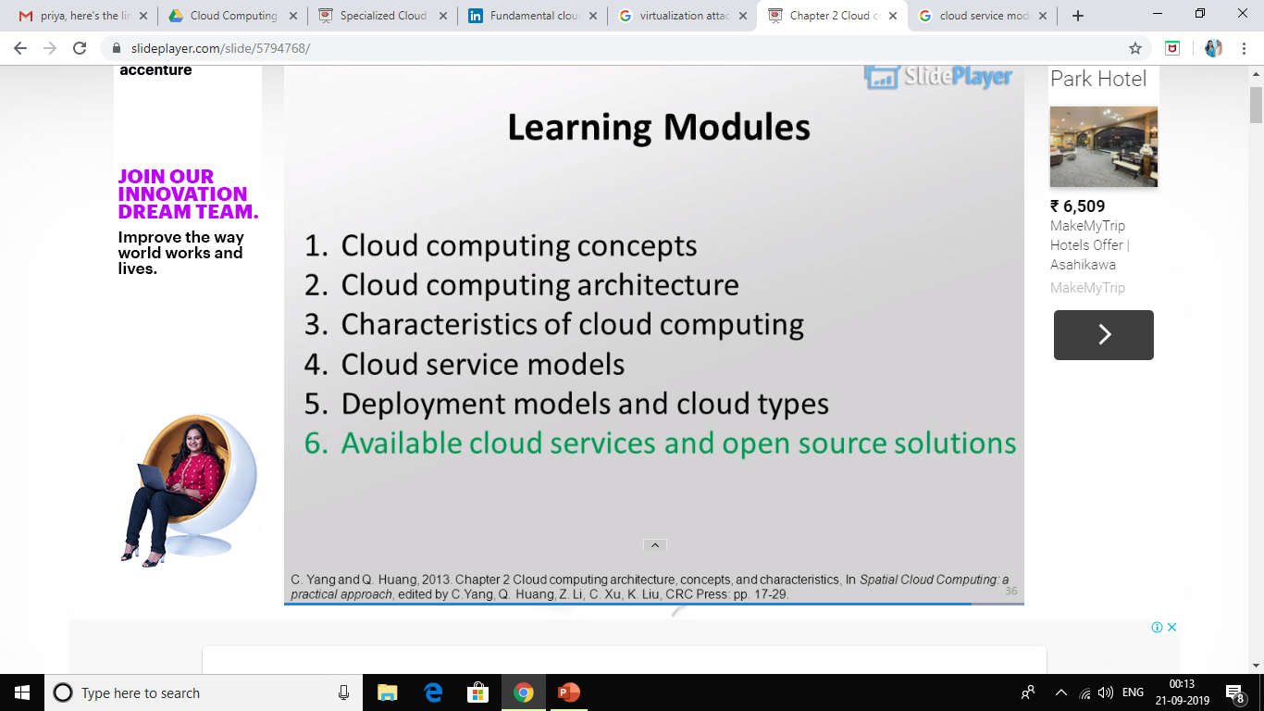

Slide 37
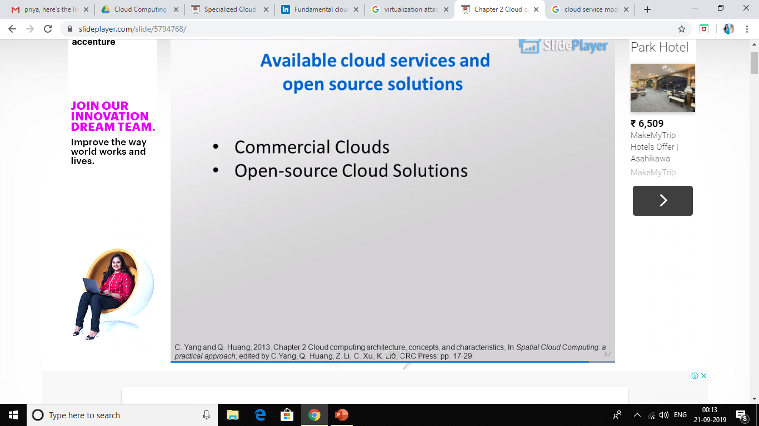

Slide 38
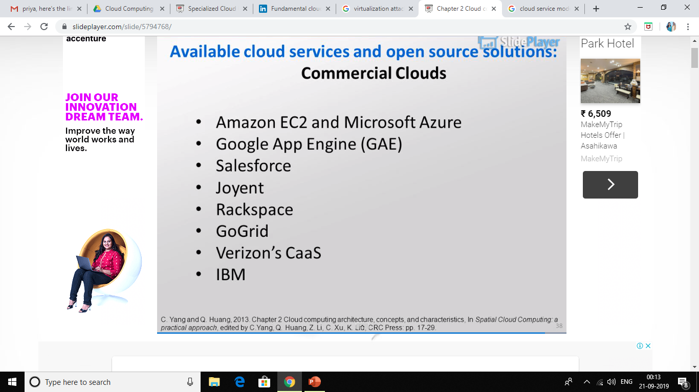

Slide 39
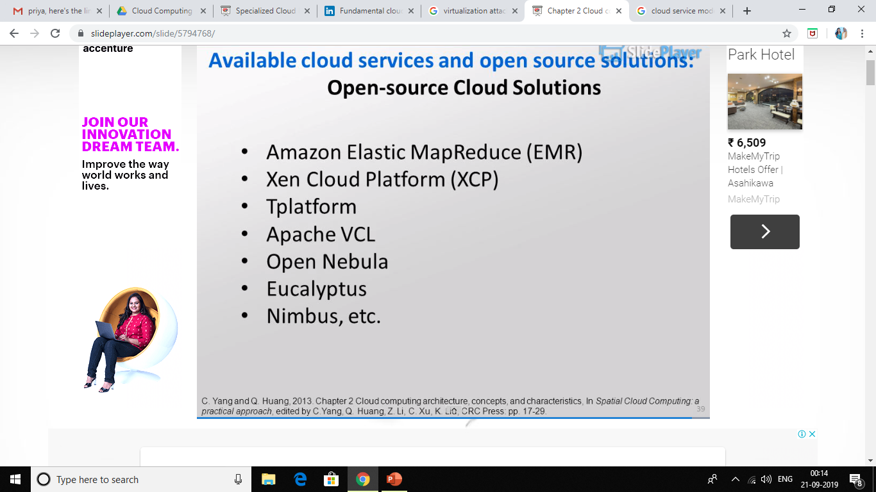

Slide 40
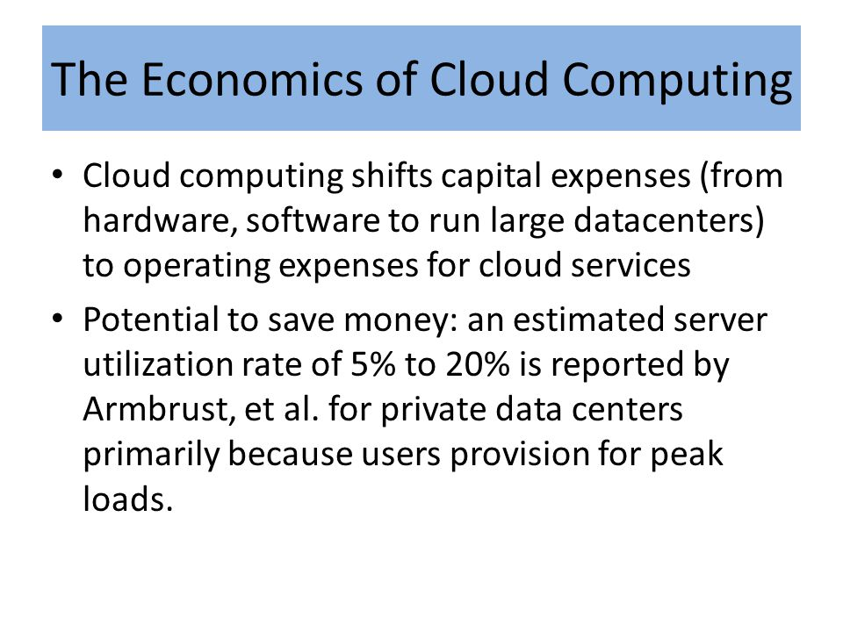
ECONOMICS OF THE CLOUD

Slide 41
CHAPTER 2 FUNDAMENTAL CLOUD SECURITY

Slide 42
Agenda 1. basic terms & concepts 2. threat agents 3. cloud security threat 4. additional considerations

Slide 43
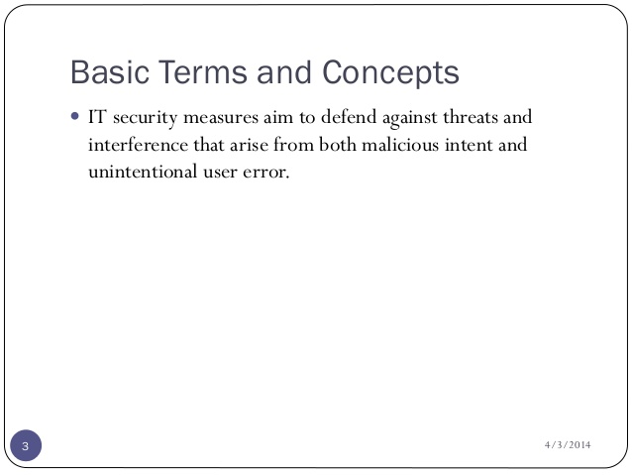

Slide 44
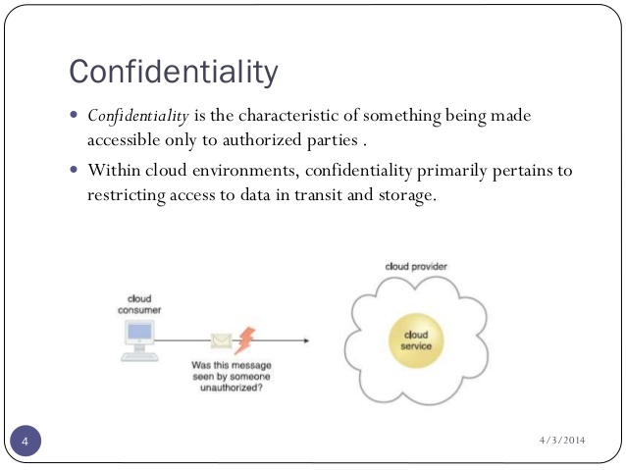

Slide 45
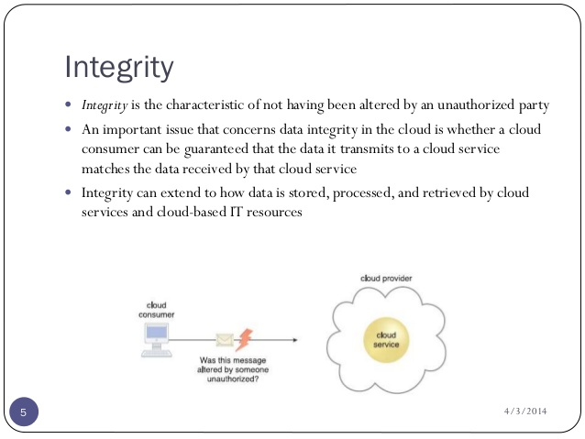

Slide 46
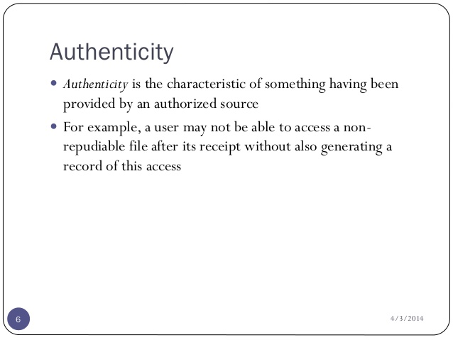

Slide 47
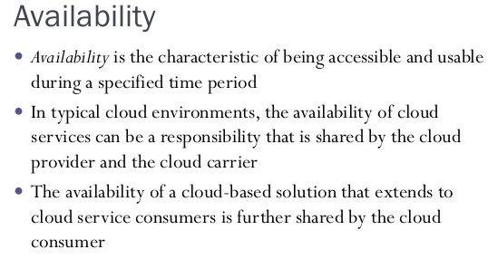

Slide 48
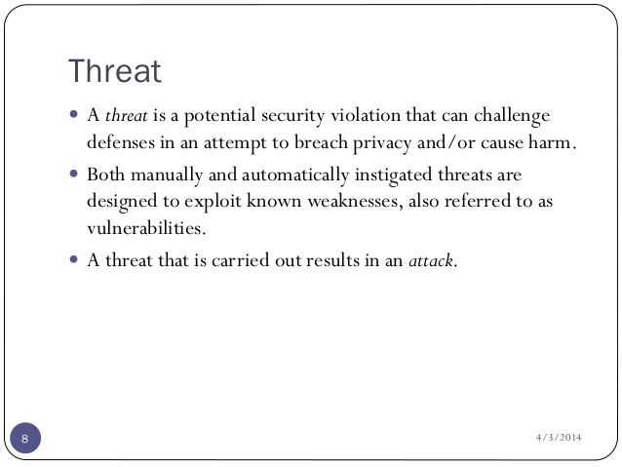

Slide 49
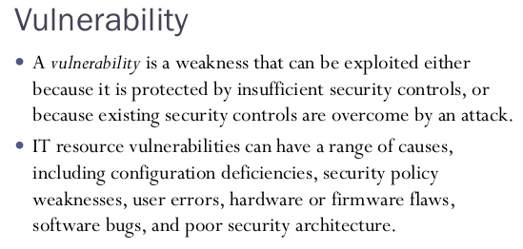

Slide 50
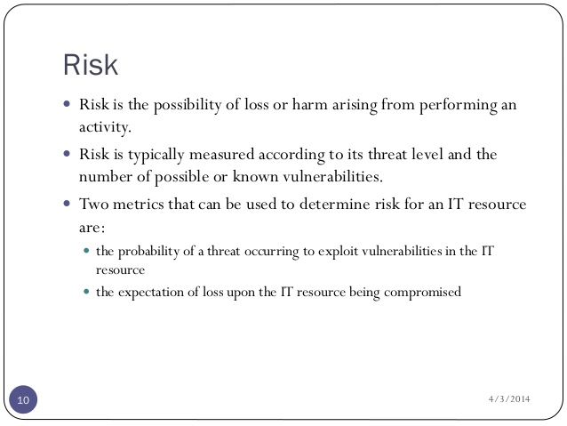

Slide 51
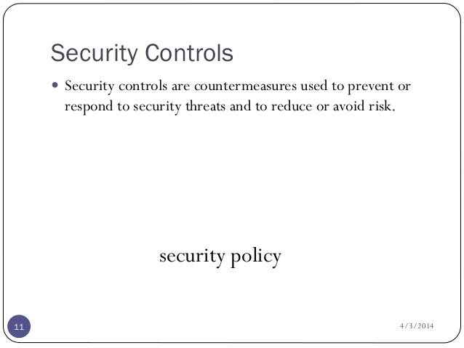

Slide 52
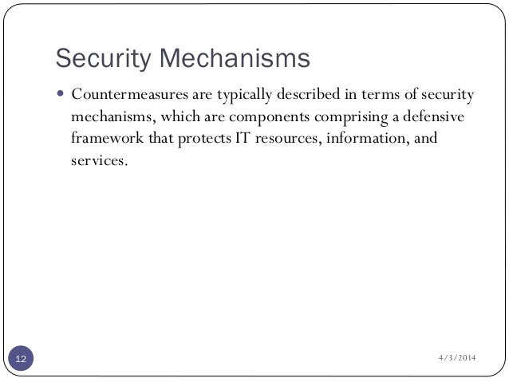

Slide 53
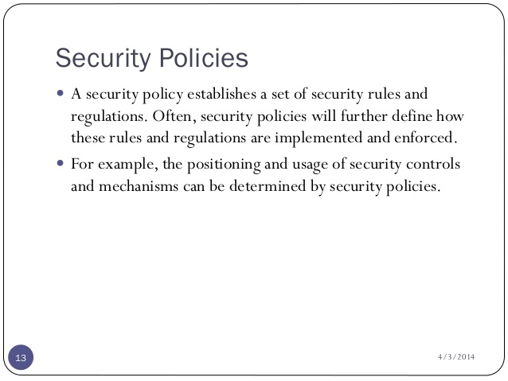

Slide 54
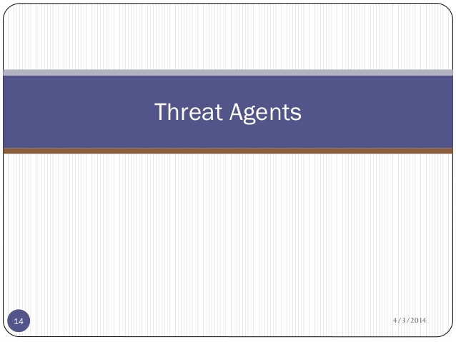

Slide 55
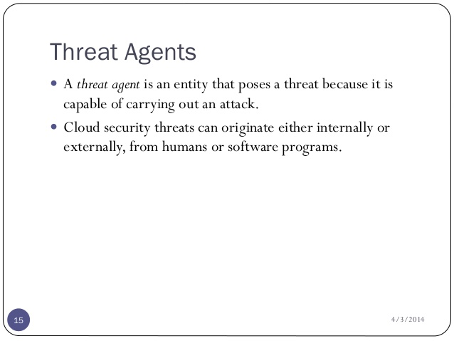

Slide 56
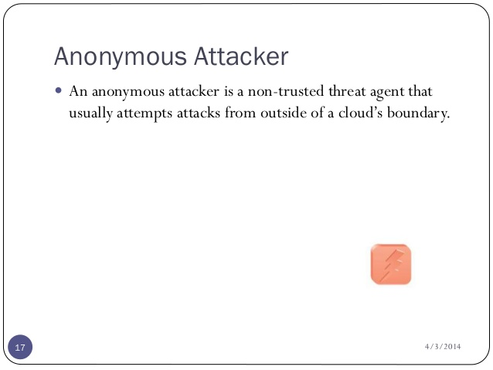

Slide 57


Slide 58


Slide 59


Slide 60


Slide 61


Slide 62


Slide 63


Slide 64


Slide 65


Slide 66


Slide 67


Slide 68


Slide 69


Slide 70
CHAPTER 3 PLATFORMS AND NEW DEVELOPMENTS

Slide 71

Utility Computing – EC2
Amazon Elastic Compute Cloud (EC2):
Elastic, marshal 1 to 100+ PCs via WS,
Machine Specs…,
Fairly cheap!
Powered by Xen – a Virtual Machine:
Different from Vmware and VPC as uses “para-virtualization” where the guest OS is modified to use special hyper-calls:
Hardware contributions by Intel (VT-x/Vanderpool) and AMD (AMD-V).
Supports “Live Migration” of a virtual machine between hosts.
Linux, Windows, OpenSolaris
Management Console/AP

Slide 72
EC2 – BASICS
Load your image onto S3 and register it.
Boot your image from the Web Service.
Open up required ports for your image.
Connect to your image through SSH.
Execute you application…

Slide 73

Google App Engine
This is more a web interface for a development environment that offers a one stop facility for design, development and deployment Java and Python-based applications in Java, Go and Python.
Google offers the same reliability, availability and scalability at par with Google’s own applications
Comprehensive programming platform irrespective of the size (small or large)
Signature features: templates and appspot, excellent monitoring and management console

Slide 74

Windows Azure
Enterprise-level on-demand capacity builder
Fabric of cycles and storage available on-request for a cost
You have to use Azure API to work with the infrastructure offered by Microsoft
Significant features: web role, worker role , blob storage, table and drive-storage

Slide 75
Thank
You

Slide 76

Cloud Computing in
Health Sector

Slide 77
What does a patient need?
It’s simple: the ability to
record medical history as well as current data, including health events, test results, vital stats, medications.
communicate this data to health care providers.

Slide 78
Cloud in Health Sector
Cost : Cloud programs, platforms and storage take the IT strain away from individual organizations instead of having everything in-house and paying for server capacity and programs that you might only use occasionally.
Scalability : Cloud computing can be instantly and almost infinitely expandable. Instead of whenever you want to use a new program it has to be installed or upgraded and tested on multiple machines.
Ubiquity : Cloud computing can help by making the same application available over a large geographic area, without the need for “custom plumbing” to connect all the disparate systems.
Home monitoring, whereby data from measurement devices (e.g., a glucometer) are streamed to a provider’s private cloud with end-to-end encryption.
Collaboration : Storing patient data in centralized databases for restricted access by authorized persons (e.g., for research purposes). Storing practice guidelines in public clouds and exchange experience.
Risk : Cloud automates the process of providing multiple, geographically dispersed backups, meaning that even a natural disaster in one area is unlikely to take down your IT systems.

Slide 79

Swine Flu Response Centre
At the peak of the H1N1 (swine flu) pandemic, one of the big challenges for health authorities in affected countries was dealing effectively with the massive number of people needing assessment and guidance.
The H1N1 Flu Response Center (http://h1n1.cloudapp.net), built and deployed on Windows Azure, allows users to take an Emory University-designed flu self-assessment, and then offers the appropriate advice.
Users can give explicit consent to share the anonymous information they provide during self-assessment for public health, education and research purposes.
As a result, apart from the assessment and advice given to the individual, the application also provided valuable aggregated information for assessing the progress of the epidemic.
Using the Windows Azure platform allowed the application
to be deployed to the cloud very quickly, making it available to the public.
increased demand and usage was handled effectively by the scalability features of Windows Azure – without investing in servers and data centers.

Slide 80

Cloud Computing in
Agriculture

Slide 81


AGRICULTURE in the Cloud!
Crop planning, monitoring, and irrigation optimization system.
Presented by Centrivision Inc. in WATERHAKATHON 2011 in Egypt.
Introduce Agriculture As A Service

Slide 82
Cloud Advantages to Farmers
Farm Cloud
No capital investment by farmer
No Servers
No Software
No Maintenance
No Data backups
No Infrastructure
Share his information with farmers planting the same crops to exchange expertise.
Farmer 1
Farmer 2
Farmer 3
Farmer 4

